Slide 1
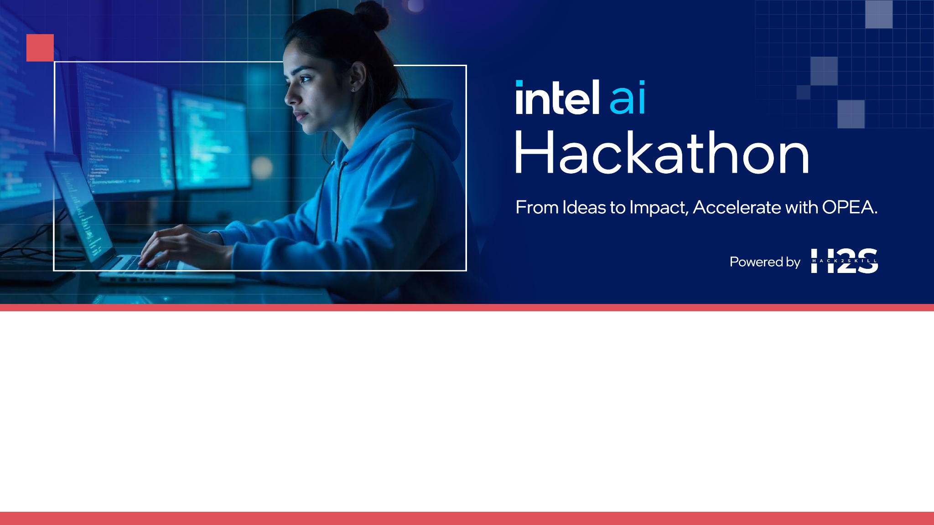
Team Name : Alchemy of codes
Team Leader Name : Manish Upreti
Theme: Multi-modal Enterprise Insights

Slide 2

Team Members:
Piyush Joshi
Manish Upreti

Slide 3
Brief Overview
Enterprise data is scattered—across emails, dashboards, meetings, support tools, CRMs, and chats—making it hard to see the full picture. Our AI-powered platform connects the dots across text, voice, visuals, and structured data to surface clear, actionable insights. It helps teams move faster and make smarter decisions with confidence.

Slide 4
Motivation/Stats
90% of enterprise data is unstructured and often siloed. Managers waste over 20% of their time just searching for relevant info.
IBM: 80% of data is unstructured.
McKinsey: Effective data usage can increase productivity by up to 25%.
References: IBM Watson reports, McKinsey Digital Transformation Studies.

Slide 5
Proposed Solution/Architecture
Input Modalities:
Text (emails, documents)
Charts (dashboards, visual PDFs)
Voice (meeting recordings)

Slide 6
Proposed Solution/Architecture
Architecture Flow:
Text (Ingestion Layer: Upload/email/chart/voice input
Preprocessing: OCR for charts, ASR for voice, NLP for text
Fusion Layer: Align insights across modalities
Insight Engine: LLM + rule-based summarizer
Output: Unified dashboard or natural language response

Slide 7
Tech Stack
Voice: Whisper, HuggingFace ASR models, Assembly AI
Text: LangChain + OpenAI/Gemini
Charts: PyMuPDF, Tesseract OCR, ChartGPT
Backend: Python (FastAPI), Docker
Frontend: Streamlit or React (optional for demo)
Storage: PostgreSQL / Vector DB (like FAISS)
Cloud: Intel OPEA or AWS/Azure

Slide 8
Assumptions
Enterprises have access to emails, dashboards, and recorded meetings.
Noise in voice data can be handled via preprocessing.
Limited multi-language support initially (focus on English).
Some data (e.g., charts) may lack metadata.

Slide 9
OPEA platform and microservices usage
OPEA Integration:
Use OPEA NLP services for text processing
Intel Optimized Inference APIs for speed
Microservices:
Ingestion service (per modality)
Fusion service (merge insights)
Output generation (NLP-driven)
All containerized via Docker

Slide 10
Novelty and Expected Results
Novelty:
Unified multi-modal enterprise insight system
Contextual insight generation, not just summarization
Real-time query response from mixed inputs
Expected Results:
Reduce decision-making time by 40%
Improve information retrieval accuracy by 60%
Enable voice-to-dashboard Q&A (e.g., “What was our revenue trend last quarter?”)

Slide 11
